Slide 1
Extracting, Transforming, and Loading Data
Extract Data
Transform Data
Load Data

Slide 2

Extract Data

Slide 3






You Are Here (Identify & Collect)
Frame the Problem
Identify & Collect Data
Process Data
Analyze Data
Finalize the Project
Train Models

Slide 4
Datasets
Dataset: A collection of data that can be used to accomplish business goals.
Data does not always start out in a neatly packaged form.
Individual pieces might span multiple repositories.
Data might be mixed in with irrelevant or dissimilar data.
You'll need to place data with one or more sets.
Example: Data repository with information about salespeople.
Data describing the same ideas is already in one place.
May be considered a dataset.
Example: Database A has customer demographics, B has actual transaction info.
Data is spread out and takes different forms.
Will be difficult to work with as is.
Must be placed into one or more sets.
Datasets can include any kind of data that's relevant to your goals.
Might be unique to your industry/organization.

Slide 5
Structure of Data
Structured:
Facilitates searching, filtering, or extracting data.
E.g., spreadsheet or database.
Chunks of data can be retrieved using a programming or querying language.
Unstructured:
Not easy to query.
E.g., images, video, textual contents, etc.
Usually a larger proportion of data than structured data.
Semi-structured:
Aspects of both structured and unstructured.
E.g., email content is unstructured, but email fields are structured.
Some formats (like XML and JSON documents) can be in different forms.
Server log output could be structured.
Human-authored documents may not be structured.

Slide 6
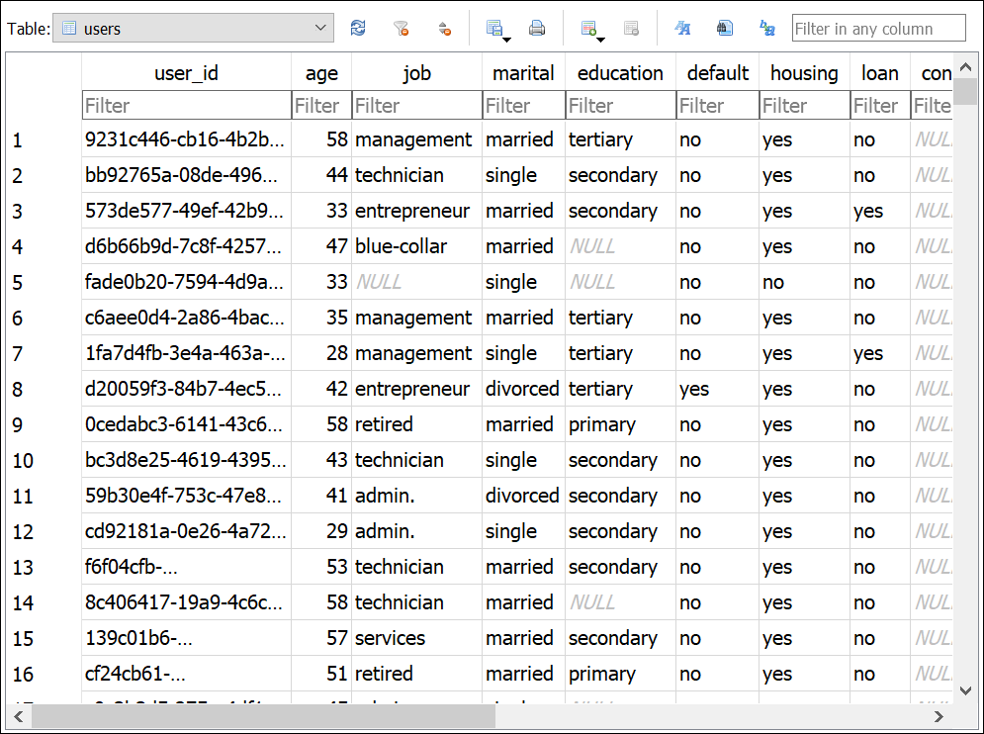
Terms Describing Portions of Data
Feature
Data example
Value

Slide 7
Data Quantity
Refers to number of examples, number of features, or both.
Table can have many rows, many columns, or both.
Document can have many total words and many different types of words.
Different types of quantity can impact tasks like machine learning differently.
Generally, the more features you have, the better the model.
With only 2 features, model will struggle to find meaningful differences between examples.
Even if you have a lot of features, a low number of examples can be a problem.
E.g., 80 columns but only 10 rows.
Model may not be able to make a good estimation.
Large number of examples can minimize effects of bad data.
Not always feasible to have a high-quantity dataset.
Rule of thumb: At least 10 times as many records as features.
More would be even better.

Slide 8

Big Data
Volume
Petabytes
Terabytes
Gigabytes
Megabytes
Kilobytes
Variety
Unstructured data
Audio, video
Images
Structured tables
Simple data values
Velocity
Batch
Periodic
Near real time
Real time
Big Data

Slide 9

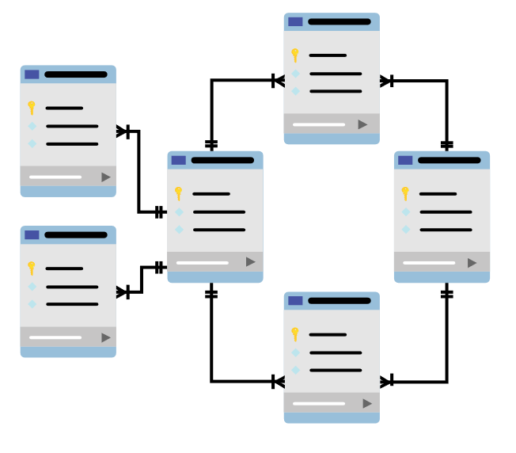

Data Sources
Data Lake
Data Warehouse
Data Mart
DEV
SALES
1110
0010
11101100101101010100110101010011
0110010110101010011010101
10101001010010010101010
111100100100101010101
0000101010101
HR
IT
001
Operational Data Store

Slide 10
Third-Party Data
Sometimes internal data isn't enough.
Example: You have customer transaction data, but not demographic data.
You may need to get data from third parties.
Organizations provide data services to clients.
Client may rely entirely on third party, or only for a portion of overall data.
Always research third-party data even if you haven't planned to use any.
Could reveal new types of data, or more of existing data.
Some data is harder to come by or considered best collected by experts.
Demographic data among large populations is difficult to obtain.
Census bureaus are a good source.
Market data usually comes from large financial/news organizations.
Bloomberg, Wall Street Journal, Reuters, etc.

Slide 11
Open Datasets
University of California Irvine Machine Learning Repository
https://archive.ics.uci.edu/ml/index.php
Kaggle
https://www.kaggle.com/datasets
Registry of Open Data on AWS
https://registry.opendata.aws/
Microsoft Research Open Data
https://msropendata.com/
Open Media Library (OpenML)
https://www.openml.org/
Government repositories
https://data.europa.eu/euodp/data/dataset
https://www.data.gov/
https://data.gov.uk/
https://data.gov.in/
https://open.canada.ca/

Slide 12
Public APIs
Application programming interface (API): A service that facilitates interaction between multiple software environments.
Provides programmatic access to data and related functions.
Easier to work with data dynamically.
Example: Department of Agriculture has various APIs:
Food Data Central
Organic INTEGRITY Database API
PubAg Database
Many APIs available, including popular ones from Big Tech companies.
APIs are usually web based.
Connect to service endpoint, then issue requests.
Check provider's website for documentation.
Most public APIs require a key.
Limits how many connections/requests you can issue in a period of time.
Usually free to sign up for a key.

Slide 13
Public API Example
Connect to Food Data Central API using Python:
import requests
foods = \ requests.get('https://api.nal.usda.gov/fdc/v1/foods/list?&pageSize=1&api_key=DEMO_KEY')
print(foods.json())
Issues GET request to /foods/list endpoint.
Uses demo key.
Returns data in JSON format.
Output:
[
{
'dataType': 'Survey (FNDDS)',
'description': '100 GRAND Bar',
'fdcId': 1104067,
'foodNutrients': [
{
'number': '203',
'name': 'Protein',
'amount': 2.5,
'unitName': 'G',
}
],
'publicationDate': '2020-10-30',
}
]

Slide 14
Extract, Transform, and Load (ETL)
Extract, transform, and load (ETL): The process of combining data from multiple sources, preparing the data, and loading the result into a destination.
First major phase with hands-on practice.
ETL takes a mess and cleans it up.
Without ETL, the modeling phase will run into many issues.
Model performance will be impaired.
Project will slow down.
Business goals will go unfulfilled.
One of the most time-consuming phases in data science.
Especially with big data.
Every dataset is different and requires a methodical approach.
High-level steps:
Extract data from various sources.
Transform data into proper formats.
Load data into a destination.

Slide 15
Data Validation
Upfront validation can make later transformation easier.
At this point, correct large, prominent errors.
Don't bother with granular errors yet.
Example: One file among many is corrupt.
You can validate the files and pull out the corrupt one.
Example: Data is out of date.
If you can validate the age of the data, you can cull the data you don't want.
Quick validation at the front end of ETL can save time and effort.

Slide 16
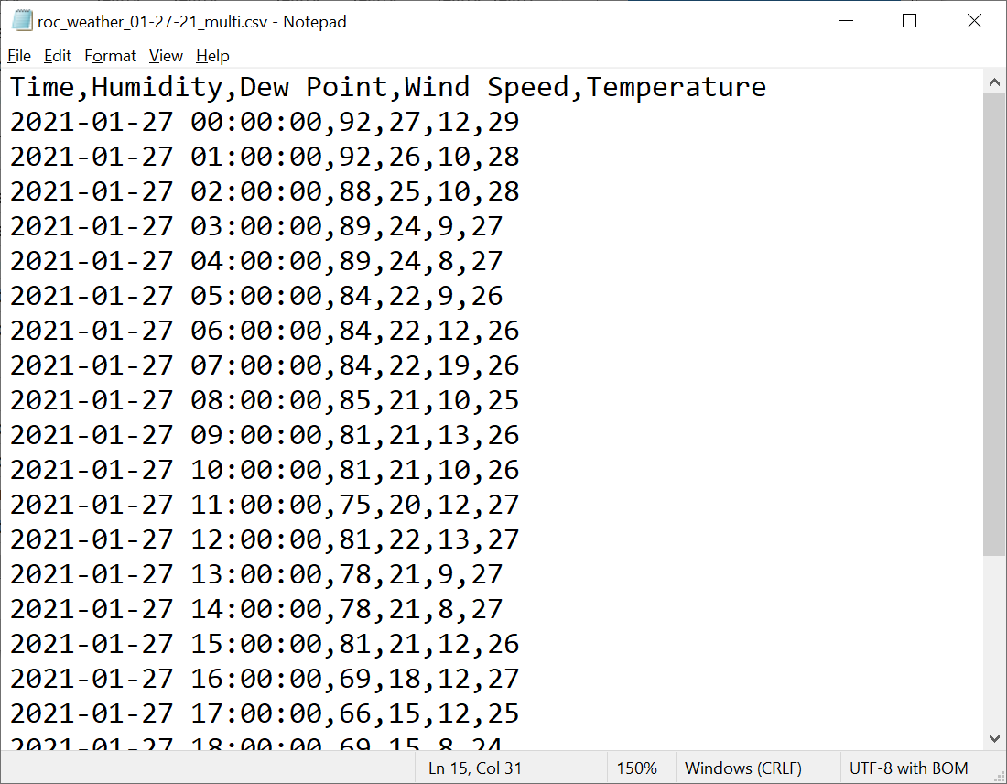
Comma-Separated Values (CSV) Files
Delimiter
Column labels
First row
Time value
Dew Point value

Slide 17
Data Read from CSV Files
Data science environments read CSV files to appear as tables.
Easier to understand and work with.
Languages like R and Python can read CSV files as objects.
data.frame and DataFrame, respectively.
Common read options:
What data type(s) to use.
What row should be the column headers.
What column should be the row indices.
What character indicates a comment.
What character is the delimiter.
Most options are inferred if not specified.
E.g., '1.23' is parsed as a string because of the quotes.
First row is usually parsed as column headers.
Make sure you verify the file was parsed correctly.
CSV files are used to share open datasets.
Not as common for serious storage in businesses.

Slide 18
Guidelines for Reading Data from CSV Files
Ensure records are consistently formatted.
Ensure delimiters are consistent.
Ensure column headers/row indices are parsed correctly.
Ensure comments or unwanted rows/columns aren't read into the data.

Slide 19
Reading Data from CSV Files

Slide 20
SQL Query Example: Retrieve One Column of Data
SELECT name FROM employees
id | name | department | yrs_service
1 | John | HR | 5
2 | Roberta | HR | 2
3 | Ted | Finance | 8
4 | Alyssa | Finance | 9
5 | Genevieve | IT | 10
6 | Andrew | IT | 3
name
John
Roberta
Ted
Alyssa
Genevieve
Andrew

Slide 21
SQL Query Example: Filter Data by a Specific Column Value
SELECT * FROM employees
WHERE department = 'HR'
id | name | department | yrs_service
1 | John | HR | 5
2 | Roberta | HR | 2
3 | Ted | Finance | 8
4 | Alyssa | Finance | 9
5 | Genevieve | IT | 10
6 | Andrew | IT | 3
id | name | department | yrs_service
1 | John | HR | 5
2 | Roberta | HR | 2

Slide 22
SQL Query Example: Aggregate Data Using a Function
SELECT department, AVG(yrs_service) AS avg_yos
FROM employees
GROUP BY department
id | name | department | yrs_service
1 | John | HR | 5
2 | Roberta | HR | 2
3 | Ted | Finance | 8
4 | Alyssa | Finance | 9
5 | Genevieve | IT | 10
6 | Andrew | IT | 3
department | avg_yos
HR | 3.5
Finance | 8.5
IT | 6.5

Slide 23
NoSQL Queries
NoSQL: Any non-relational database system.
Not a specific technology, but a type of database.
Popular with big data.
Fast and efficient with large volumes of unstructured/semi-structured data.
Approaches:
Key–value: Unique identifier (key) is associated with one or more values.
Document: Data is stored in a structured document format.
Wide-column: Data is stored in non-relational tables.
Graph: Data is represented by nodes that connect to other nodes.
No universal querying standard.
Differs based on approach and technology.
Some solutions offer RESTful APIs for querying.
Consult your solution's documentation.

Slide 24
Guidelines for Extracting Data with Database Queries
Ask yourself:
How frequently will new data be available?
How frequently will data be refreshed from the source?
How available and accessible will the data be?
When dealing with data access:
Implement permissions on databases and tables.
Prefer read-only access.
Coordinate when data will be accessed.
When extracting data:
Use efficient queries for the task.
Use indices where possible for query criteria.
When dealing with large volumes of data:
Keep in mind queries on large data will take longer.
Limit number of columns in a query.
Consider breaking up datasets into multiple subsets.
Track data that has already been collected.

Slide 25
Extracting Data with Database Queries

Slide 26
Data Read from Cloud Storage
Storing data in cloud is popular for big data needs.
Extracting data differs between provider and service.
Major storage object storage solutions:
Amazon S3
Google Cloud Storage Buckets
Azure Blob Storage
All three provide web-based APIs for retrieving data.
Providers also offer data lake solutions in the cloud.
AWS and Google Cloud provide solutions that use existing services to create a data lake.
Azure Data Lake is a distinct service.

Slide 27
Data Consolidation
Combine similar data into a streamlined form for easier transformation/loading.
One way to consolidate is on the data values.
Example: One source tracks kitchen appliances, the other cutlery.
weight_lbs column in first, weight_ounces in second.
Both refer to same feature.
You can streamline this into a single column when you combine the data.
Easier to manage the data this way.
You can also consolidate on data sources as a whole.
Example: Two sources, both tracking appliances.
First source has many columns.
Second source has one column that isn't in the first.
Second source has some rows that refer to same appliance as the first, some not.
You need to merge these data sources into one without losing data.
Done using a join.

Slide 28
Data Joins
Join Type | Returns | Visual
Inner | Only rows from Table A and Table B that match.
Left outer | All rows from Table A, and column data from Table B for matching rows.
Right outer | All rows from Table B, and column data from Table A for matching rows.
Full outer | All rows from a combination of both tables.
A
B
A
B
A
B
A
B

Slide 29
Inner Join Example
books
orders
book_id | book_name | book_format
1010 | The Odyssey | Epic poetry
1020 | Othello | Play
1030 | Crime and Punishment | Novel
1040 | Bartleby, the Scrivener | Short story
1050 | Animal Farm | Novella
order_id | book_id | order_date
1 | 1040 | 2021-02-18
2 | 1050 | 2021-02-18
3 | 1010 | 2021-02-19
4 | 1080 | 2021-02-19
Query
Result
SELECT books.book_id, books.book_name,
orders.order_date
FROM books
INNER JOIN orders
ON orders.book_id = books.books_id
ORDER BY books.book_id
book_id | book_name | order_date
1010 | The Odyssey | 2021-02-19
1040 | Bartleby, the Scrivener | 2021-02-18
1050 | Animal Farm | 2021-02-18

Slide 30
Guidelines for Consolidating Data from Multiple Sources
Ask yourself:
What fields are common between the datasets?
Will you combine datasets into existing set or a new set?
How will you handle joins on missing data?
How will you handle duplicated data?
Consider how data can be consolidated.
Identify same or similar data that can be combined.
String "123.45" vs. float 123.45
£100 to $135
Imperial to metric
Language conversion
Occupation code conversion
Date conversion
Identify character set conversions.
Identify scaling factors between data points.
Consider how to get data from multiple locations into one location.
Identify data stored on local file systems, corporate intranet, cloud providers.

Slide 31
Consolidating Data from Multiple Sources

Slide 32
Transform Data

Slide 33


You Are Here (Process)
Frame the Problem
Identify & Collect Data
Process Data
Analyze Data
Finalize the Project
Train Models

Slide 34
Preliminary Data Transformation
Transformation comes after extraction in ETL.
Involves changing data in some way.
You can make changes early.
You know what to look for.
Your tools can help you find issues.
However, you won't be able to make some changes until after analysis.
Tells you what to transform and how.
Changes at this point are preliminary.
You can still get quite a bit done.

Slide 35
Data Preparation and Cleaning
Data preparation alters data so it more effectively supports data science tasks.
Tasks like analysis and modeling.
Necessary for achieving business goals.
Comprises multiple individual tasks.
Purpose is to identify issues before data is loaded into its destination.
Issues can be at a macro level or micro level.
Data cleaning addresses inaccuracies and other problems with data.
Subset of preparation.
Duplicated data, poorly formatted data, corrupt data, etc.
You can correct data or remove it.
Choice of action depends on feasibility and impact on later processes.
Data wrangling/munging are alternative terms.
Often refers to manual work.
Preparation can be automated so cleanup can repeat.

Slide 36
Types of Data
Feature types:
Quantitative
Number as a magnitude, e.g., Price.
Qualitative
Non-ranking categories, e.g., Color.
Ordinal
Ordered data, e.g., Grade.
Data types:
Integers (25)
Floats (12.78)
Strings ('Red')
Booleans (True or False)
Datetimes (2021-03-01)
These types don't always match 1:1.
E.g., a categorical feature can be represented using integers.

Slide 37
Operations You Can Perform on Different Types of Features
Feature Type | Description
Quantitative | Dataset: (13, 13, 31, 38, 72) Mean: (13 + 13 + 31 + 38 +72) / 5 = 33.4 Median: 31 Mode: 13 Range: 72 − 13 = 59
Qualitative | Dataset: ('blue', 'red', 'black', 'black', 'black') Mode: 'black'
Ordinal | Dataset: ('A', 'A', 'C', 'F', 'D') Median: 'C' Mode: 'A'

Slide 38
Continuous vs. Discrete Variables
Continuous variables are uncountable and can extend infinitely.
Example: Time it takes to run a marathon.
Can be described as taking 3 hours, 10 minutes, 37 seconds, 845 milliseconds, etc.
Continues indefinitely for perfect precision.
More realistically, time is measured with imperfect precision.
E.g., 3 hours, 10 minutes, 37 seconds.
Can still take on all real values in a range.
Uses fractions and decimal values.
Discrete variables are countable and limited.
Example: Time in Minutes
Is either 120, 121, 122, 123, etc.
There is a definite gap between each value in a range.
Cannot be divided into more precise values.
Uses whole numbers.
Difference can affect how data is treated in multiple phases of the process.
E.g., continuous variables are formatted as floats; discrete variables as integers.

Slide 39
Data Parsing
Data parsing: The process of taking data as input, then representing it in a certain structure/syntax.
You can parse raw data into well-formatted data.
E.g., each line of text in CSV file becomes a row in a table.
You can parse data to change its form.
E.g., web page with HTML converted to a DataFrame.
Parser must be capable of separating elements and translating them into destination.
Most tools can parse common data formats.
Data in formats like HTML may require more manual work.
E.g., configuring a parser to interpret the data in a certain way.
Ensure data is parsed before doing more transformation tasks.

Slide 40
Guidelines for Parsing Data
When possible, prefer to parse data from well-structured formats.
Consider that binary formats are faster to parse and take up less storage space, but cannot easily be read by a human.
Consider that binary formats may only be readable by the system or library that created it.

Slide 41
Data Irregularities
Any data that doesn't conform to expectations.
Types of problems:
Corrupted or unusable data
Incorrectly formatted data
Duplicated data
Placeholder data
Null or missing data
Identify as many instances of these problems as you can during data preparation.

Slide 42
Identification of Corrupted or Unusable Data
Some corrupted data is conspicuous and easy to identify.
Example: Color feature has one value of '����'.
Some encoding error is happening.
You can filter the data to only show valid color names.
You can remove the record or estimate a color that it's most likely to be.
Column data type can also reveal corrupted data.
DataFrame column contains one type of data.
Just one deviation will change data type; e.g., 'blue' changes Price column to a string.
You're left with '1.23', '6.34', '8.91', and so on.
You identify irregular data by its context.
Some corrupt data isn't overt, but still identifiable through domain knowledge.
E.g., city with a Population of 5.
Filter dataset to show values outside an acceptable range, e.g., 100,000 to 40,000,000.
Some corrupt data is difficult to identify.
E.g., population of 3,567,100 is reasonable but still incorrect for a specific city.
Compare data to other values to get context.
Look for patterns of irregular data.

Slide 43
Guidelines for Handling Irregular and Unusable Data
Keep in mind that irregular data is data that has inconsistencies between records.
Correct data with inconsistent columns between records before input.
Consider the different ways to handle irregular data:
By utilities or apps within or outside conventional data science tools.
On the data source itself before it is exported to a data science environment.
By manual processes.
Consider that, often, the only way to handle unusable data is to create it from source.

Slide 44
Handling Irregular and Unusable Data

Slide 45
Correction of Data Formats
Data sources store data in different types with different precision.
Example: Color could be a string, integer, or float.
Data types must be consistent and in a format conducive to analysis/modeling.
Cleaning involves inspecting datasets for data type issues.
Examples:
Money values cast as floats instead of decimals.
Floats cast as integers, a loss of precision.
Integers cast as floats, making data harder to interpret.
Most tools can convert data from one type to another.
Conversion has to be logical for it to work.
Converting string '1.34' to float 1.34 will work.
Converting string 'two' to an integer won't work.
Most values can be converted to strings.

Slide 46
Date Conversion
Date can be represented as a string, e.g., '2021-03-01 00:03:50'.
March 1st, 2021 at 3:50 A.M.
A lot of distinct information is being conveyed.
No easy way to extract individual portions.
There are many ways to format dates and times.
How do you retrieve just months no matter the format?
The datetime format stores dates/times consistently.
Easy to extract/query individual components.
E.g., dt.month() can retrieve integer 3 or string 'March'.
Raw dates/times may be pulled into an environment as strings.
You can configure environments to parse them as datetime instead.
Don't have to worry about making the format consistent.
Other libraries can also help convert strings to datetime objects.

Slide 47
Guidelines for Correcting Data Formats
Date values:
Consider that dates come in many formats.
Consider that there are many formal and informal date formatting standards.
Keep in mind that dates formatted with the year at the end of the string can be ambiguous.
Consider your knowledge of the source data when deciding how to transform dates.
For easiest processing, normalize dates in all data sources.
Numeric values:
Consider that numeric values can take many forms in data files.
Keep in mind that some data science tools will ignore embedded digit group separators.
Keep in mind that numeric values can have a leading + or - to indicate sign.
Keep in mind that negative numbers can be surrounded by parentheses.
Keep in mind that binary values are not human readable.

Slide 48
Correcting Data Formats

Slide 49
Deduplication
Deduplication: The process of identifying and removing duplicate entries.
Duplicates can lead to problems with analysis and modeling.
Most common example is where multiple rows have same exact values:
Most libraries can identify and remove duplicate entries like these.
Some duplicate rows have only one or two values in common.
If one of them is the primary key, it's obvious you have a duplicate.
May not be clear which row is correct and which should be dropped.
Customer ID | Last Name | First Name | Country | Gender
1056 | Williams | Emily | CA | F
1056 | Williams | Emily | CA | F
1056 | Williams | Emily | CA | F

Slide 50
Deduplication Without a Key
Some evidence of duplication can be deceptive.
Customer ID is not the primary key.
This dataset is transactional.
One customer can have multiple transactions.
So, these are not duplicates.
In the absence of common key, it may be unclear what is correct and what is an error.
You must have a deep understanding of your dataset to identify and address issues.
Customer ID | Sale Price | Tax | Quantity | Product
1056 | 799.99 | 63.99 | 1 | TV
1056 | 78.99 | 6.32 | 2 | Speakers
1056 | 199.99 | 15.99 | 1 | Subwoofer

Slide 51
Deduplication of Columns
A column could appear twice and hold the same values for each row.
Or, two columns might hold different raw values but still be redundant.
Time in Hours is redundant with Time in Minutes.
Both measure same thing, but on different scales.
One of these columns could be removed.
Knowledge of the data is once again important.
Name | Place | Time in Minutes | Time in Hours
Romano | 2 | 176 | 2.93
Alvarez | 3 | 201 | 3.35
Matthews | 1 | 168 | 2.80

Slide 52
Guidelines for Deduplicating Data
Keep in mind that data that has been duplicated between different files can be difficult to discover and correct after it has been transformed.
Be systematic when collecting data.
Deduplicate data if there is a value that is guaranteed to be unique within a data record.
Deduplicate records by using ad hoc scripts, third-party libraries, or applications.
Deduplicate data as early as possible in the data pipeline.
Perform checks to ensure that no duplicate records exist.

Slide 53
Deduplicating Data

Slide 54
Word Embedding
Review feature includes written text.
Not quite categorical, not quite ordinal.
You need to transform this data somehow.
Embedding condenses language vocabulary into vectors of small dimensions.
Average adult knows 40,000 words.
Each word has its own vector.
All vectors together form embedded space.
A word's vector occupies a point within this space.
When trained on neural networks, similar words are placed close by in embedded space.
Many word embeddings already exist that you can use.
You can also train your own using tools like:
Word2vec
fastText
TF-IDF
GloVe

Slide 55
Text Data Transformation Techniques
'The shadows, gleams, up under the leaves of the old sycamore-trees'
Technique | Description
Bag-of-words | Puts all words in a list without grammar or punctuation. {'the': 3, 'shadows': 1, 'gleams': 1, 'up': 1, 'under': 1, 'leaves': 1, 'of': 1, 'old': 1, 'sycamore': 1, 'trees': 1}
Tokenization | Partitions text into smaller units. ['g', 'l', 'e', 'a', 'm', 's']
Stop words | Removes common words that add no value. ['the', 'up', 'under', 'of']
Stemming | Removes affix to get base form of word. 'shadows' → 'shadow' 'leaves' → 'leav'
Lemmatization | Analyzes word structure to intelligently derive base dictionary form of word. 'leaves' → 'leaf'

Slide 56
Image Data Representation (Slide 1 of 2)
Raw image can be represented as array of numeric values.
Each cell represents a pixel
Greyscale: 0 is black, 255 is white, and shades of grey in between.
Color: RGB value.
Convolutional neural networks (CNN) compress images to eliminate noise.
Derive features from image that are most useful in detecting patterns.
Latent representations are "hidden" in network.
You can extract latent representations as vectors.
Use them as input to another model.
Speeds up process and improves results.
Use them to determine similarities, e.g. using cosine similarity.
Remove too-similar images to streamline data.

Slide 57

Image Data Representation (Slide 2 of 2)
Original Image
Pixel Array
Feature Vector
21
21
187
179
21
…
27
25
185
182
21
…
…
…
22
20
210
205
210
…
25
19
210
204
204

Slide 58
Guidelines for Transforming Data
Keep in mind that the goal of transforming tabular data is to make data formats uniform between columns and cells in a given column.
Keep in mind that most transformations can be done with third-party tools.
Including documentation, tests, and versioning for conversion scripts.
Maintain and update conversion scripts as needed.
Ensure that dates have a common representation.
Determine whether or not currency should have leading or trailing symbols.
Add a column that indicates a currency code using a standard like ISO 4217.
Remove symbols for grouping digits by thousands, millions, etc.
Consider expanding scientific notation to use a floating point representation.
Keep in mind that some numbers have a prefix or suffix indicating magnitude.
Consider that most data science tools assume an ASCII character set.
Consider that strings can be surrounded by:
Straight quotes (' and ")
Guillemets (« and »)
Smart quotes (‘ ’ and “ ”).

Slide 59
Handling Textual Data

Slide 60
Load Data

Slide 61
Data Loading Considerations
Refers to putting cleaned data into an ultimate destination.
The prepared dataset.
Used to analyze and model domain problems.
Consider:
Choice of data format
Depends on available tools, comfort level, and business decisions.
Storage capacity
More data requires more storage.
Memory capacity
Data must be stored temporarily in memory to be operated on.
Pipeline integration
Pipelines should be able to load data into the desired formats.
Collaboration
Loaded data must be in a form that all team members can access.

Slide 62
Data Loading: Databases
Can be SQL or NoSQL depending on data structure needs.
Preferred option for larger organizations and complex data science projects.
Databases are designed to handle data storage and manipulating efficiently.
Querying data can move it from the workspace to a database.
Easier if data is well prepared.
Most databases run on servers.
Ensures availability and reliability.
Continuously monitored.
Supports authentication and authorization.
Supports data integrity.
Supports data confidentiality.
Work with your IT team to help set up databases.
Explain needs for capacity, access rights, and data structure/technology.

Slide 63
Guidelines for Loading Data into Databases
Look at data files and the targeted database's schema to determine which database tables and columns the data will be loaded to.
Decide where every piece of data in your data file will be loaded to.
Load data with a custom-written program, data science tool, or a bulk-loading program.
Consider writing a small program to load data if it will be loaded regularly.
Collect and analyze missing data or erroneous data and decide if this will violate any data integrity rules and make data inconsistent.

Slide 64
Loading Data into a Database

Slide 65
Data Loading: DataFrames
Might want to keep your data in a format that closely integrates with your programming environment.
E.g., keeping data in a pandas DataFrame if you're using that data science stack.
No need to issue queries or send data to a server.
You can save a DataFrame to a binary file so it isn't as volatile.
Python has a pickle file format for this.
You can just load the data back into your environment when needed.
DataFrame will appear exactly as you left it.
No additional parsing needed.
Disadvantages:
Data is fractured and difficult to manage.
Untrusted binaries can contain malware.
No centralized authentication/authorization.
Compatibility issues with different programming environments.

Slide 66
Guidelines for Loading Data into DataFrames
Use one DataFrame for each dataset being loaded.
Decide which columns are in common between datasets so data from different datasets can be combined.
Combine DataFrames after loading based on joined columns.
Keep in mind that most data science tools read all data from a file into memory at once, potentially causing slowness or errors when files are very large.

Slide 67
Loading Data into a DataFrame

Slide 68
Data Loading: Text Files
Alternative to loading data into databases or binary files.
Not common when dealing with a lot of complex data.
Text files don't accommodate any specific structure.
They can take on an ostensible structure through delimiters like CSV files.
Just about any person or program can read a text file.
Disadvantages:
Can be searched but not queried.
No inherent data typing.
Can't store large volumes of data as efficiently.
No inherent security mechanisms.
Decentralized and difficult to manage.
Avoid loading data into flat text files unless data is:
Simple.
Low in volume.
Not sensitive.

Slide 69
Guidelines for Loading Data into Text Files
Choose the file format that is best for your needs.
Prefer CSV for the widest compatibility with all applications.
CSV files:
Advantages: compatibility, language support, parsable, readable, editable, forgiving.
Disadvantages: inefficient, one dataset per file, limited supported for delimiters.
JSON files:
Advantages: readable, editable, language support, multiple datasets, querying.
Disadvantages: inefficient, less supported than CSV, limited binary support.
XLS/X files:
Advantages: binary support, efficient, compression support.
Disadvantages: not readable, support per format varies.
Store binary data for textual file formats (JSON, CSV) in Base64.
Keep in mind that smaller files are read from and written to faster, but add the complexity of maintaining multiple files.
When writing CSV files, store less than 1,048,576 rows and 16,384 columns, and keep each column to less than 255 characters to maintain compatibility with Excel.
Select the proper options when exporting data if the data includes Unicode/UTF-8 characters.

Slide 70
Exporting Data to a CSV File

Slide 71
ETL Endpoints
Maintaining an authoritative source of data can be a challenge.
The ETL process isn't usually a straight line.
You might make mistakes or want to experiment.
Common to test ETL tasks in a development environment.
Especially through the use of scripts.
Directly reading from and writing to a database isn't the best option for this.
Endpoints are dev environments that can be configured and provisioned as needed.
Acts as an intermediary between your workspace and the database.
Feeds you the data so you can run scripts against it iteratively.
No need to directly access backend server.
You can fine tune your ETL tasks in many different scenarios.
Most endpoints are implemented as RESTful web services.
Retrieve data in XML/JSON/etc.
Common in major cloud services like AWS and Azure.

Slide 72
Guidelines for Configuring ETL Endpoints
Consider how data will be used when deciding on output formats.
Find out how to send data to the ETL tool.
Obtain permissions to use endpoints and tools.
Write custom application for help with the automation of regular loads.
Consider how often data needs to be sent.
Determine how long a data load will take to complete.
Work with the ETL provider or team to determine what data transformations will occur before data is sent to the ETL and what will be done by the ETL system.
Keep in mind that working with ETL systems often requires a dedicated team to support them.

Slide 73
Data Loading: Visualization Tools
You can load data directly into a visualization tool.
Useful if your goal is to analyze data or do some simple modeling.
Also useful for presenting results to a non-practitioner audience.
Each tool supports different file formats.
Some open, some proprietary
Tableau is the most popular suite of data visualization tools.
Can read relational databases, spreadsheets, and more.
You don't need to write code to visualize data using these tools.
But, they're not optimized for advanced tasks like machine learning.

Slide 74
Guidelines for Loading Data into Visualization Tools
Keep in mind that some visualization tools are their own data science platforms, and may integrate with other data science tools.
Only load the data to be visualized and any supporting data, as the volume of data can affect rendering or animation times.
Consider what data needs to be aggregated before visualization.
Look at the data formats required by the visualization tool and format appropriately.
Format data as much as possible before sending it to the visualization tool.

Slide 75
Exploring Data Visualization Tools

Slide 76
What kind of transformation tasks would be most applicable to the type of data you work with?
What format do you currently use or plan to use to load prepared data into?

